Slide 1

Sentimental Analysis on Truck Driver Protest
NLP- Sentimental Analysis
Atharva Kate

Slide 2
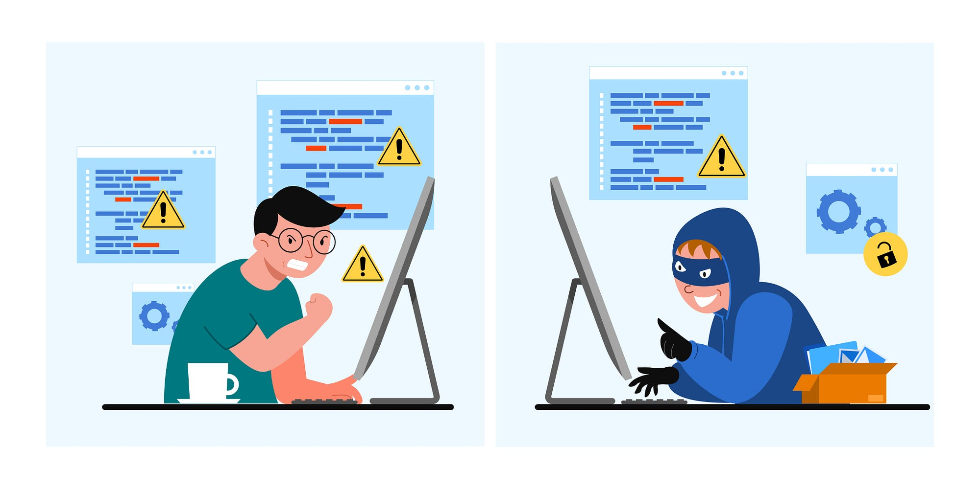
Introduction
Problem Statement: In today's world, dealing with disorganized information is hard. This project is about studying what people are saying on YouTube about recent protests by truck drivers in India. The goal is to understand what the general public thinks and feels about important social and economic events.
Key Features: This includes understanding public sentiments, optimizing content strategies, and empowering decision-makers with real-time insights.
Business Relevance: Navigate public sentiments on YouTube to refine communication strategies, manage brand perception, and engage customers effectively in the digital age. Gain insights for a positive online presence and impactful communication.
Audience Engagement: Connect better with your audience on YouTube by analyzing their comments. Respond to sentiments, creating a more engaging and enjoyable experience for your viewers.

Slide 3

Objective
To conduct comprehensive Data Pre-Processing on YouTube comments, uncovering patterns in sentiments related to recent events. Develop a predictive machine learning model for accurate sentiment predictions, aligning insights with operational efficiency and audience engagement optimization.

Slide 4
Process – Flow
Problem Statement
Fetching Data
Data Pre-Processing & Data Visualization
Model Building
Business
Conclusion on Model
Checking Accuracy & Model Deployment
Applying Algorithms

Slide 5







Tools and Platform
Tools : Python
Platform: Jupiter Notebook, Visual Studio Code
Library Used: Sklearn, Pandas, NumPy, Pickle, Matplotlib, Demoji, Googletrans, etc

Slide 6
About Dataset
Youtube
Dataset
Fetched data using Youtube
https://youtu.be/b81Na6yploU?si=Ar18yKsAyRRO9q4u
Using API, I was able to fetch almost 900 comments from the comment section of the video. This data contained various languages such as Hindi, English, Hinglish. Saved the data in csv file. Emojis, missing values were present in the dataset.
Inspiration
On the recent truck driver protests, I wanted to understand public sentiments through YouTube comments. This dataset and sentiment analysis model were inspired by the desire to explore people's opinions on this significant event.

Slide 7
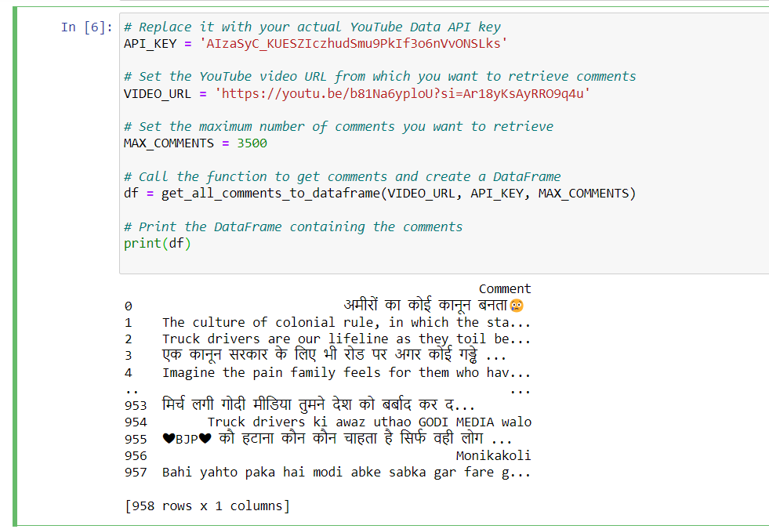
Data Insights
Using API key, I fetched almost 957 comments from 3000 comments that were present in the video. This was due to the company’s policy where as a developer, for free account and for educational purposes, YouTube allows only a specific amount of comments to fetch.
In the dataset, we have Hindi, English, hinglish, punctuations, emojis.

Slide 8
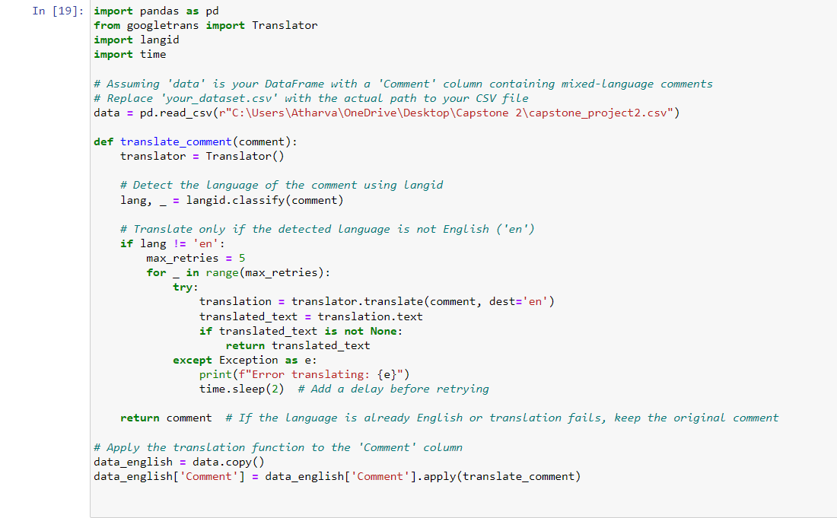
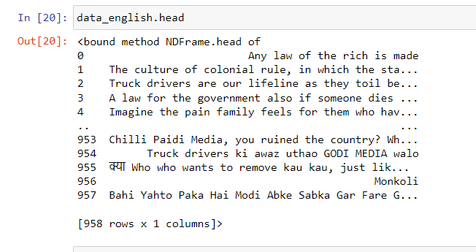
Data Pre-Processing
Converting Hindi to English
Results after converting.

Slide 9
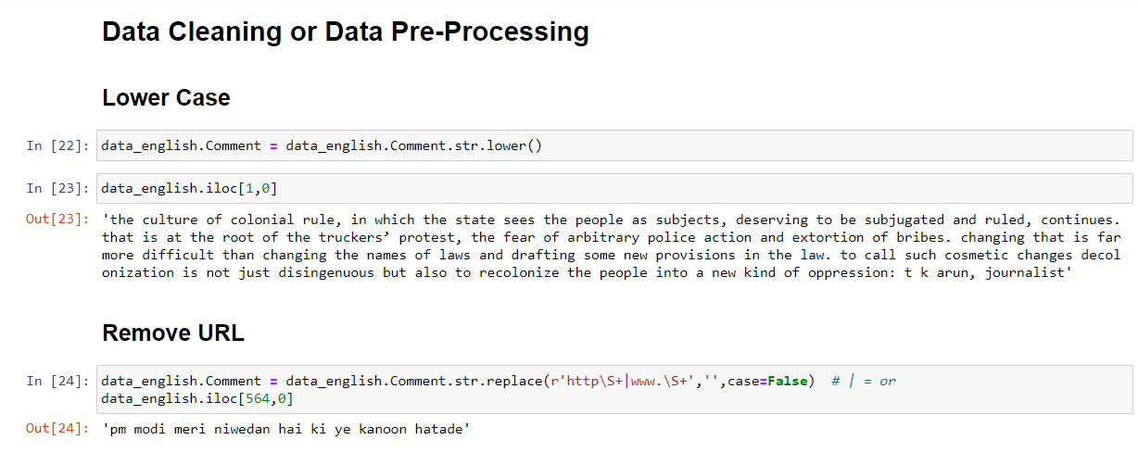
Data Pre-Processing

Slide 10
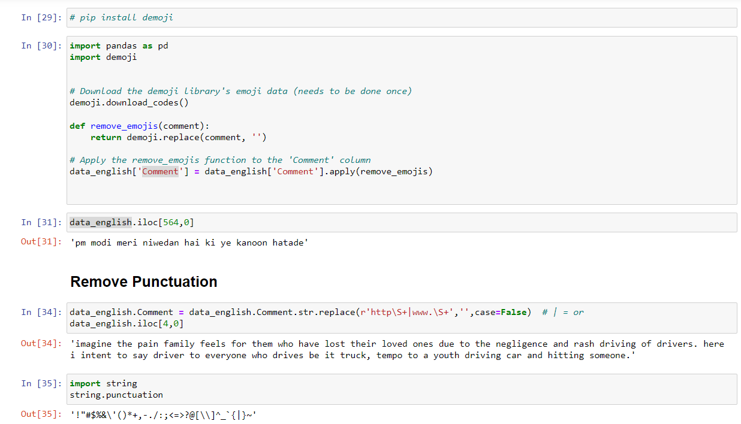
Data Pre-Processing

Slide 11
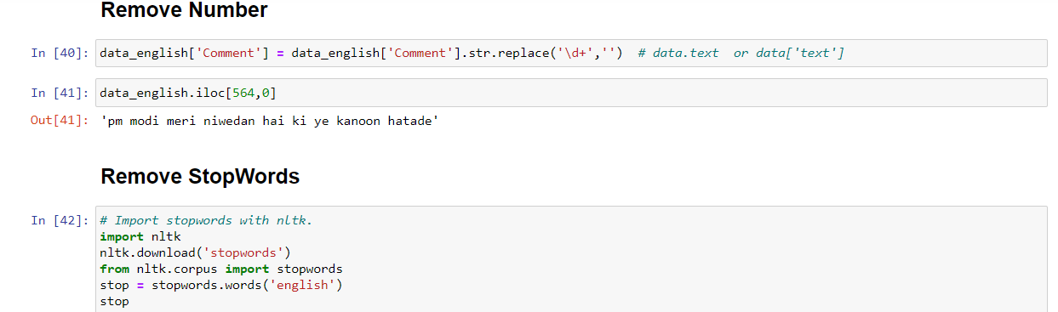
Data Pre-Processing

Slide 12
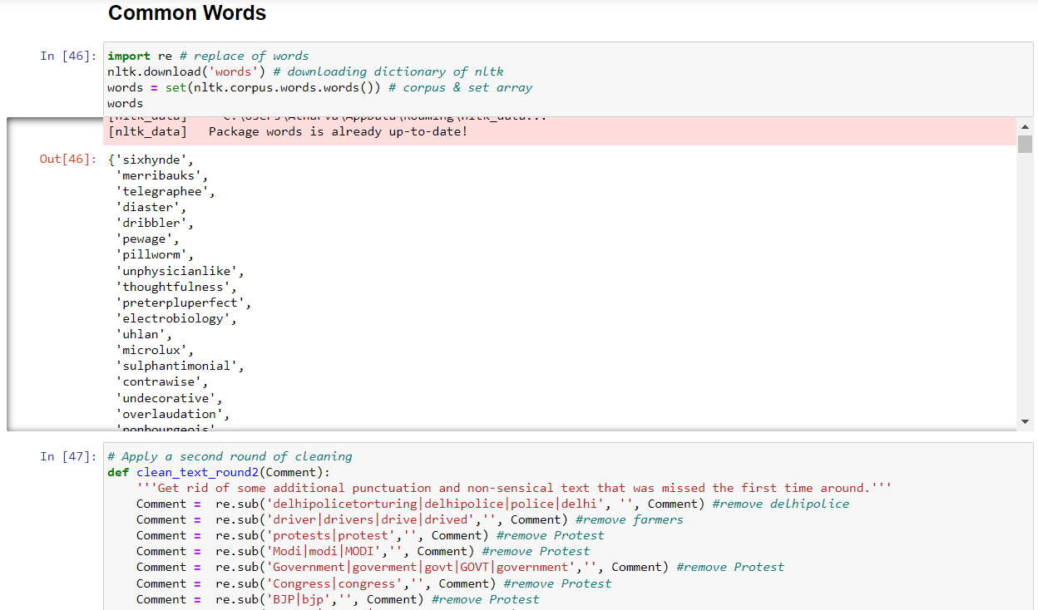
Data Pre-Processing

Slide 13
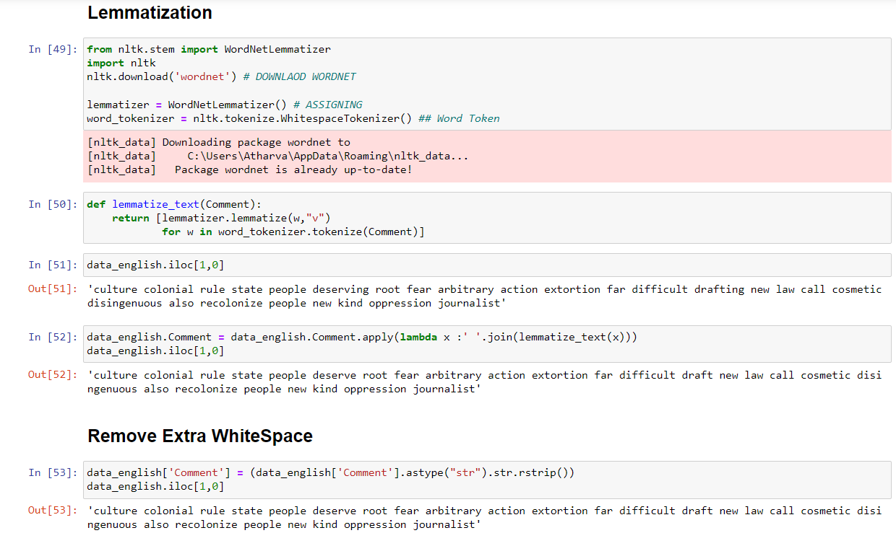
Data Pre-Processing

Slide 14
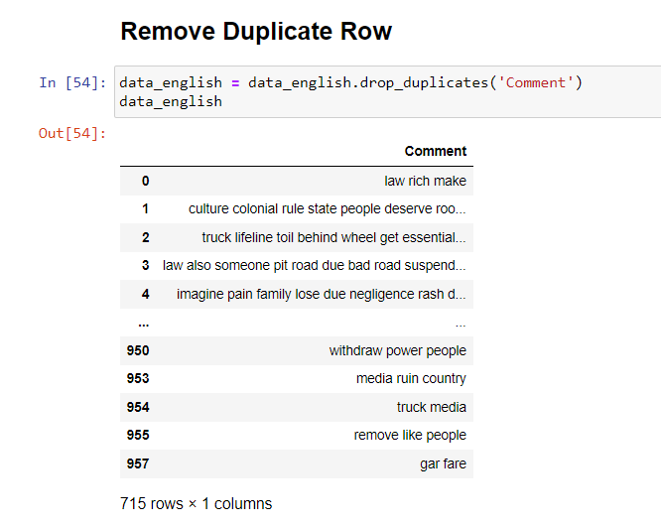
Data Pre-Processing

Slide 15


Data Partition
X_Train
Train (70 %)
Y_train
Dataset
x_Test
Test (30 %)
Y_Test

Slide 16
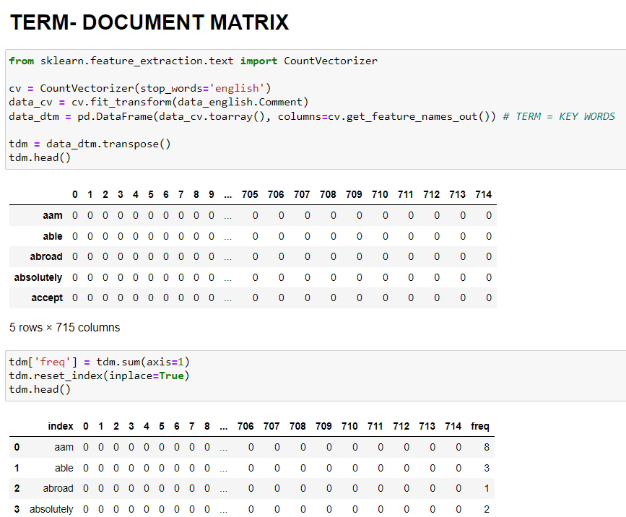
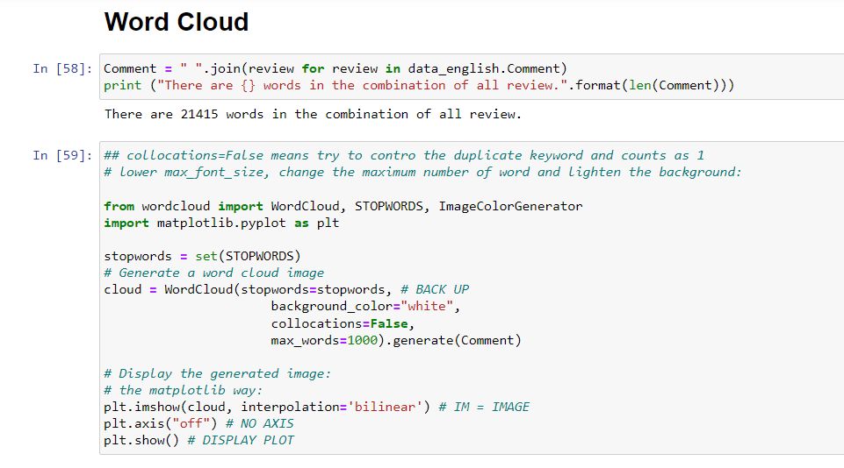
Model Building

Slide 17
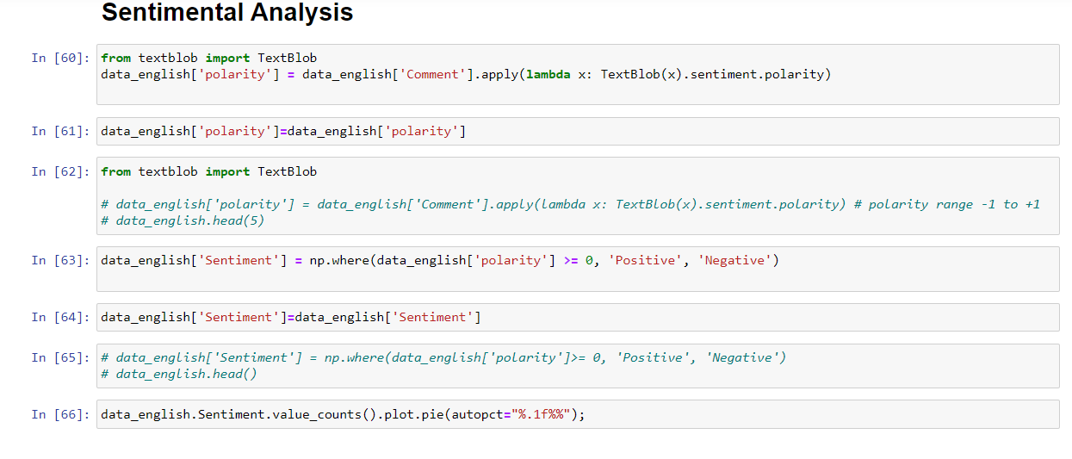
Model Building

Slide 18
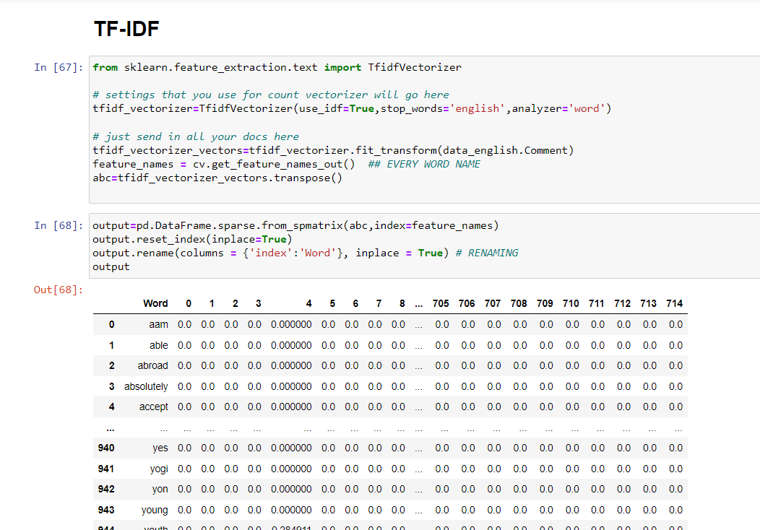
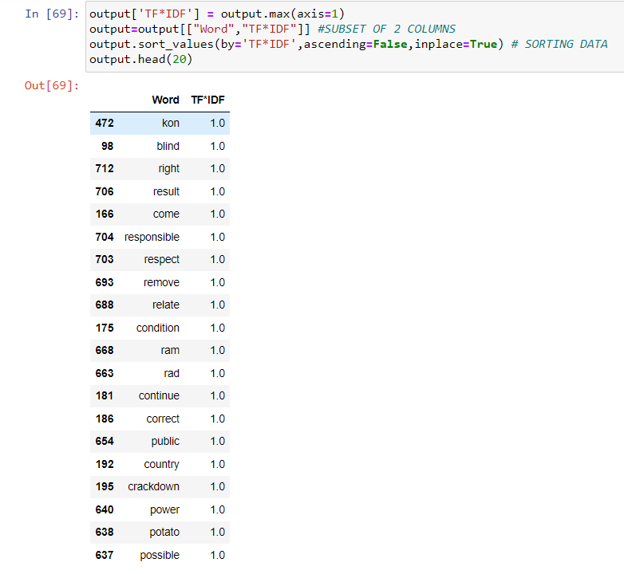
Model Building

Slide 19
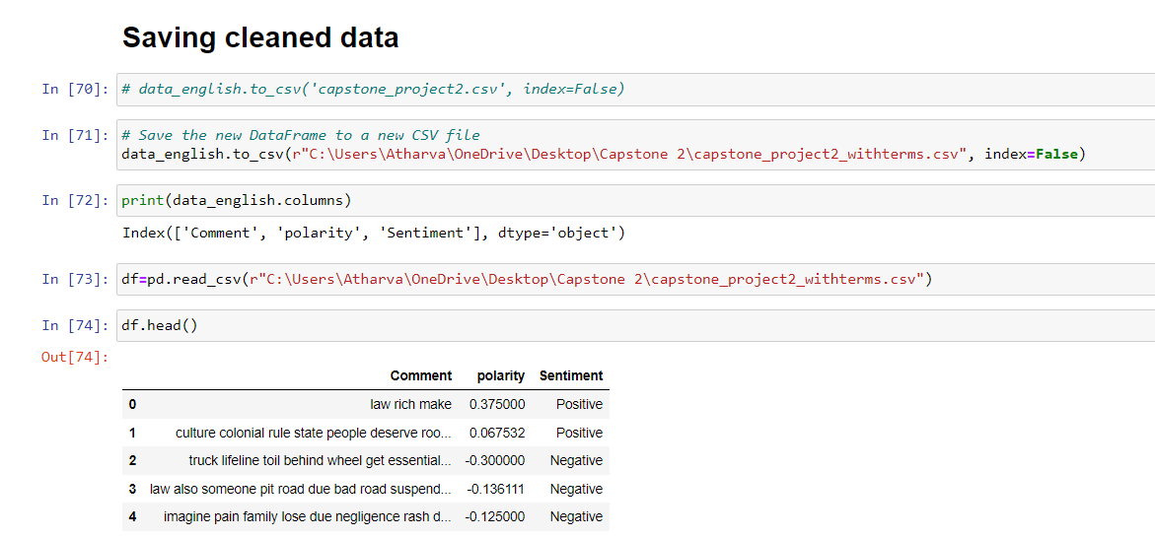
Model Building

Slide 20
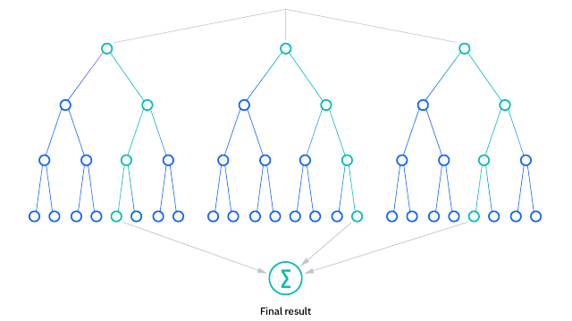
Models
Logistic Regression
Random Forest
Naïve Bayes
TF-IDF

Slide 21
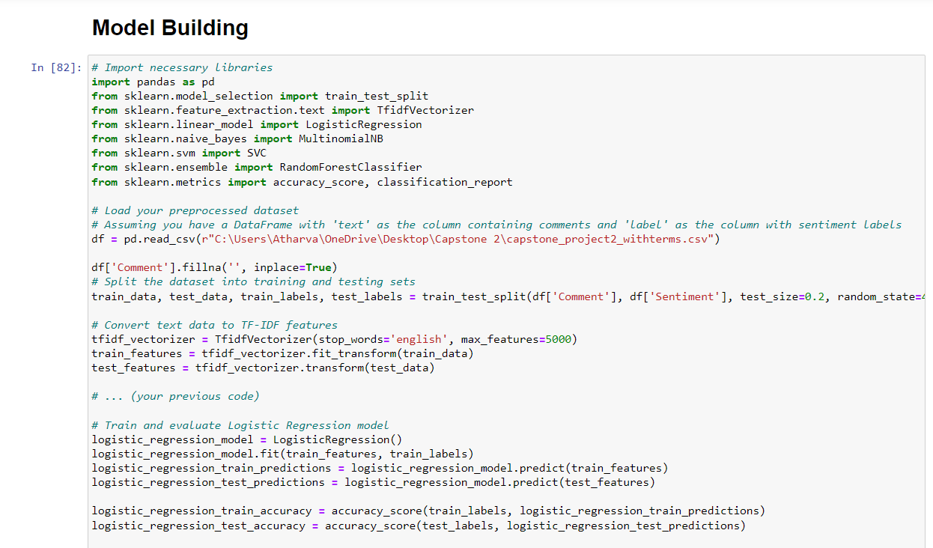
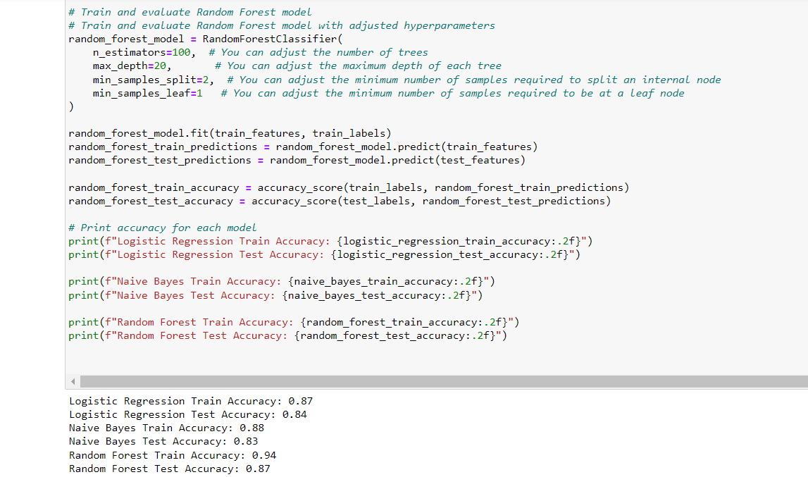
Model Building

Slide 22
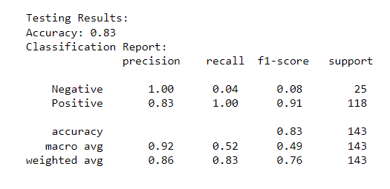
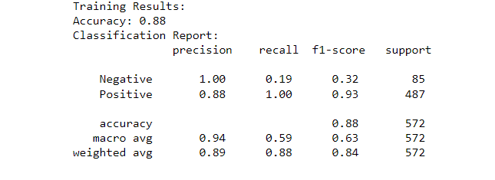
Model Building
Built a model using TF-IDF
Below are the results of the train and test data

Slide 23
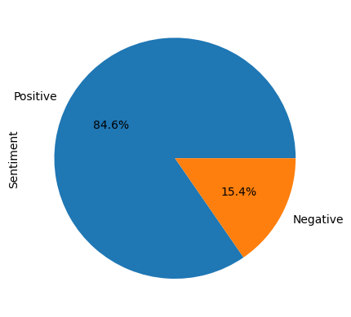
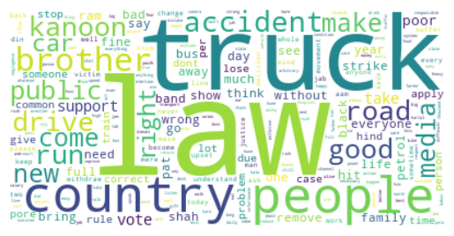
Data - Visualization
Sentimental Analysis
Word Cloud

Slide 24
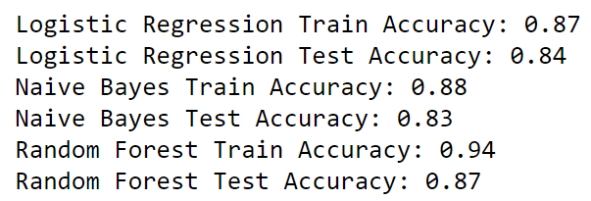
Comparision between Models

Slide 25

Conclusion
Based on the performance of the models, we choosed to build a model on TF-IDF Model as:
They are more interpretable, and you can analyze the importance of specific words in determining sentiment.
They are simpler compared to Random Forest, and they might be easier to deploy and maintain.
They are not limited to sentiment analysis. They can be adapted for various text-based tasks, such as topic modeling or document clustering.
Also based on the size of dataset, there was no need to use a complex model such as Random Forest.

Slide 26
Challeneges
Data Preprocessing: The initial dataset required extensive cleaning and preprocessing due to inconsistencies, missing values, and noise in the YouTube comments. Also language translation was required.
Sentiment Labeling: Manually labeling sentiments for training the model was time-consuming, as sentiments had to be assigned to a large number of comments accurately.
Model Evaluation: Selecting the most suitable machine learning model posed a challenge. Iterative testing and evaluation were necessary to find the model with optimal accuracy. As target variable was absent, we need to assign the sentiments as target variable as to build a model.
Overfitting: Some machine learning models, like Random Forest, exhibited overfitting, necessitating further refinement to improve generalization.
Resource Constraints: Large datasets and complex models demanded substantial computational resources, impacting the speed of experimentation and development.

Slide 27
Business and Business Applications
Brand Monitoring: Companies can use sentiment analysis to monitor and analyze public opinions about their brand or products. This helps in understanding customer satisfaction and identifying areas for improvement.
Social Media Management: Social media managers can use sentiment analysis to track the sentiment of social media comments and posts related to a brand. This allows for timely responses to customer feedback, addressing concerns, and engaging with positive sentiments.
Product Feedback Analysis: Businesses can analyze sentiment in product reviews to identify strengths and weaknesses. Positive sentiments can be highlighted as product features, while negative sentiments can guide product improvements.
Customer Support Enhancement: Sentiment analysis can be integrated into customer support systems to automatically categorize and prioritize user feedback. This enables quicker responses to negative sentiments and enhances overall customer support.
Market Research: Companies can use sentiment analysis to analyze market trends and consumer preferences. This information can be valuable for making informed business decisions and staying ahead of market dynamics.

Slide 28
Business and Business Applications
Content Strategy: Content creators and marketers can leverage sentiment analysis to understand how audiences are reacting to their content. This insight can guide content strategy, helping to create more engaging and relevant content.
Brand Image and Reputation Management: Monitoring sentiment helps in managing and enhancing brand image and reputation. Timely responses to negative sentiments can mitigate potential PR issues.
Competitor Analysis: Sentiment analysis can be applied to monitor the sentiment around competitors. Understanding how consumers perceive competitors' products or services can inform strategic decisions.
Financial Markets: In the finance industry, sentiment analysis can be used to analyze social media and news sentiments related to stocks and financial instruments. This information can be valuable for making investment decisions.
E-commerce Personalization: E-commerce platforms can use sentiment analysis to personalize the user experience. For example, recommending products based on the sentiment of users' reviews or feedback.

Slide 29
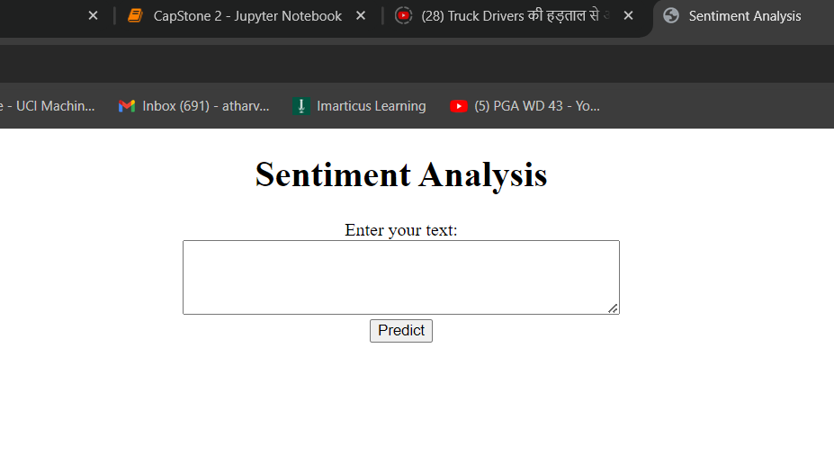

Model Deployment
Using VS code, a model is made so that it would predict the outcome. Here when the details are provided, it will predict “Positive ” or “Negative”.

Slide 30

My Learnings
Learned to convert regional language into English language.
Explored various new libraries.
Learned to build a Machine Learning model on topic such as NLP.
Created a mindset of business prespective.

Slide 31

Thank You
Github: https://github.com/AtharvaKate2001
LinkedIn: www.linkedin.com/in/atharva-kate2001
Instagram: https://www.instagram.com/aspiring_data__scientist/
Youtube: https://www.youtube.com/@AspiringDataScientist01

